Slide 1
My Taxi Service
Project of Software Engineering II
Students:
Giuseppe Manzi (mat. 854470)
Alessandro Nicolini (mat. 858858)

Slide 2
Assignment 1: RASD
Requirement Analysis and Specification Document

Slide 3
WHAT IS IT?
ORIENTED TO
THE CLIENTS
ORIENTED TO THE PROGRAMMERS
It’s a document
UNAMBIGUOUS

Slide 4
SO…
ORIENTED TO
THE CLIENTS
ORIENTED TO THE PROGRAMMERS
Very detailed requirements
Few words and simple to read
Many schemas (UML)
UNAMBIGUOUS

Slide 5
LEADING IDEA
We assumed to have NO pre-existent computerized information system
WE DECIDED TO PROJECT A SOFTWARE THAT DOES EXACTLY WHAT THE ACTUAL SYSTEM DOES

Slide 6
G2
Allow taxi drivers to have a personal reserved area that helps them managing rides.
G3
G1
GOALS
G4
G5

Slide 7
Allow guest users to request a taxi to reach him to a specific address as soon as possible.
G2
G1
G3
GOALS
G4
G5

Slide 8
Allow costumer to
have a personal reserved area. In addition to functionalities provided to guest users, a registered costumer can reserve a taxi for a specific time, check previous requests and reservations
and modify or delete them
G2
G1
G3
GOALS
G4
G5

Slide 9
G2
G1
G3
GOALS
Guarantee a fair queue management
G4
G5

Slide 10
G2
G1
G3
GOALS
Manage the distribution of the taxis in each zone and notify taxi drivers the need to move from a zone to
another one.
G4
G5

Slide 11
REQUIREMENTS
related to G2
3.2.2 - [G2] Allow guest users to request a taxi to reach him to a specific address as soon as possible.
[R2.1] Guest users can insert an address and a mobile phone number and ask for a taxi coming as soon as possible to there.
[R2.2] If enough taxis are available, the system assigns one of them to each incoming guest request.
[R2.3] The code of the taxi assigned to a guest request is sent by SMS to the number the costumer provided during the request.

Slide 12
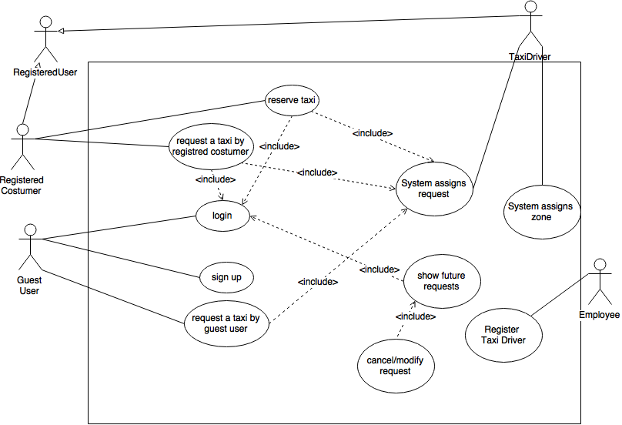
USE CASES

Slide 13
A USE CASE
Guest User Requests a Taxi
Name | Guest user requests a taxi
Actors | Guest user, taxi driver
Goal | [G2], [G4]
Related requirements | [R2.1], [R2.2], [R2.3], [R4.11]
Basic flow | Guest user fulfils the fields “address” and “phone number”; Guest user submits the request; The system invokes the use case “system assigns a request”; The system sends a text message with taxi code to the phone number provided during step 1; The taxi driver get to the given address and confirms the presence of the costumer;
Exit conditions | The taxi has been assigned to the request and the taxi driver accepted; The taxi state is unavailable.
Exceptions | 1.a. Address does not exists: 1.a.1 The app/site shows an error message; 1.a.2 Back to step 1. 5.a. Costumer isn’t there: 5.a.1 Taxi driver notify the system that costumer is not there; 5.a.2 The system move the taxi driver to the front of the queue.

Slide 14
A USE CASE
Guest User Requests a Taxi
Name | System assigns a request
Actors | Taxi driver
Goal | [G4]
Related requirements | [R4.2], [R4.3], [R4.9], [R4.10]
Basic flow | The system inserts the request as last element of the queue of the zone the address belongs to; When all the previous requests has been managed, the system assigns the first taxi in the queue of the zone to the request and set the taxi state as unavailable; The app notifies taxi driver and he accepts to manage the ride;
Exit conditions | The taxi has been assigned to the request and the taxi driver accepted; The taxi state is unavailable.
Exceptions | 2.a No taxi is available: 2.a.1 A text message of unmanageable request is sent by the system to the phone number provided during step 1; 3.a Taxi driver declines the request: 3.a.1 The system moves taxi driver to the back of the queue; 3.a.2 Back to step 2.

Slide 15
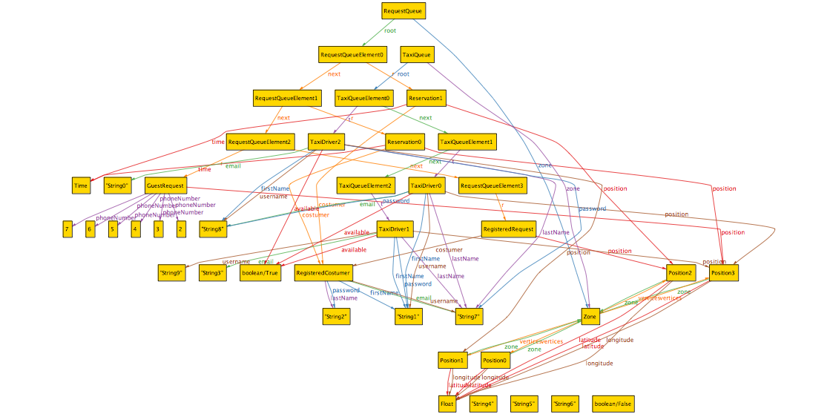
ALLOY STATE SPACE

Slide 16
Assignment 2: DESIGN DOCUMENT

Slide 17
ARCHITECTURAL
DESIGN
We will provide an objected oriented design, which is based on entities and on their interaction, consistent with the past object oriented analysis of the RASD.
We choosed the 3-Tier style because of the need to separate the Client from the Server and to store and protect sensible data in a DBMS and for the high system performances that we want to reach.

Slide 18
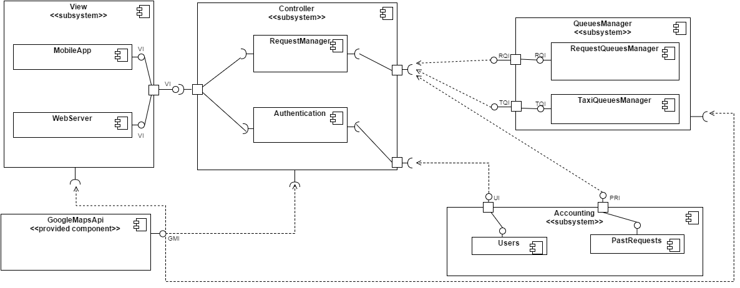
COMPONENT VIEW

Slide 19
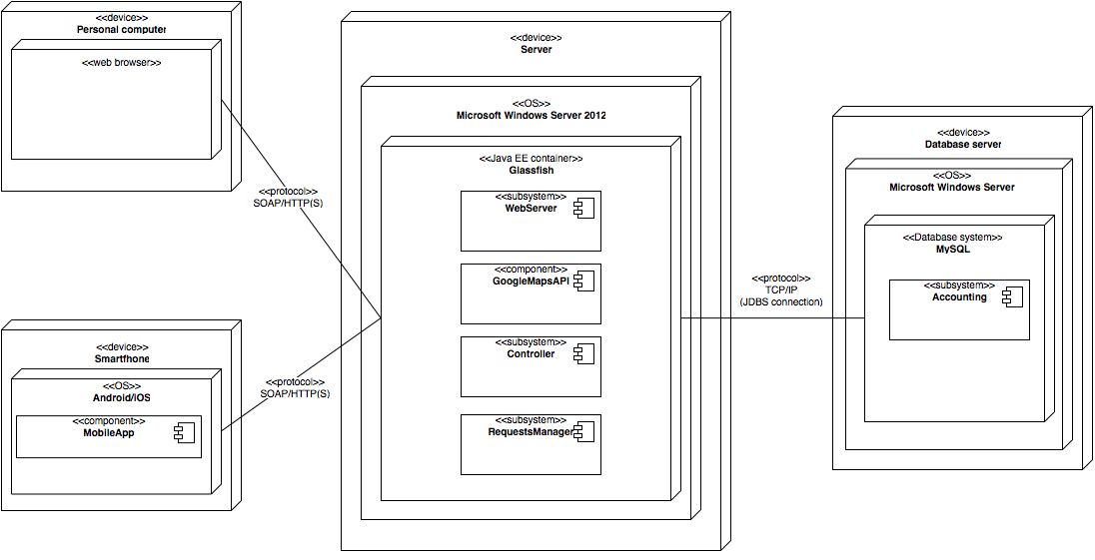
DEPLOYMENT VIEW

Slide 20
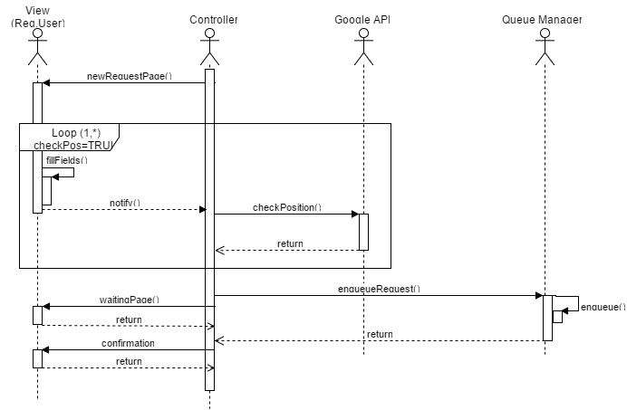
SEQUENCE DIAGRAMS
Add Request

Slide 21
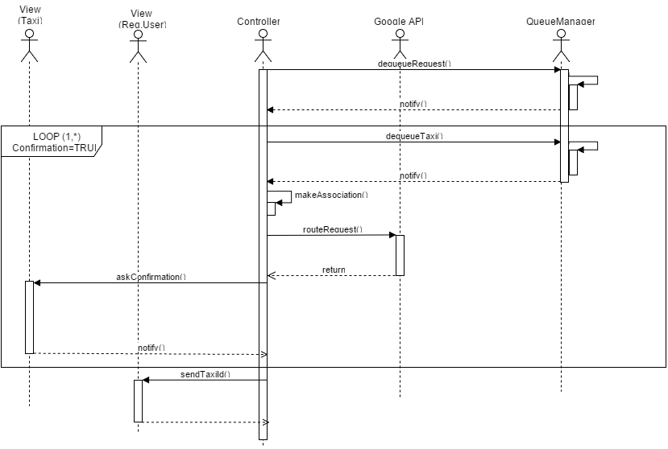
SEQUENCE DIAGRAMS
Request Association

Slide 22
COMPONENT INTERFACES
RequestsQueueManagerInterface
void enqueueRequest(Request req)
void dequeueRequest()
TaxiQueueManagerInterface
void enqueueTaxi(TaxiDriver t)
void insertTaxiAsFirstItem(TaxiDriver t)
void dequeueTaxi()
UserAccountingInterface
void lookForAccount(String username)
void addAccount(String username, String password, String firstName, String lastName, String email)

Slide 23
COMPONENT INTERFACES
PastRequestsInterface
void storeRequest(RegisteredRequest r)
void storeReservation(RegisteredReservation)
void lookForListOfRequests(String username)
ViewInterface
void createHome()
void createPersonalAreaHome(Class typeOfUser)
void createNewRequestPage()
void createNewReservationPage()
void createWaitingPage()
void createEnqueuedRequestPage()
void askConfirmation(String taxiDriverUsername, Position pos)
void notifyTaxiId(String id)

Slide 24
Assignment 4: INSPECTION AND
TEST PLAN

Slide 25
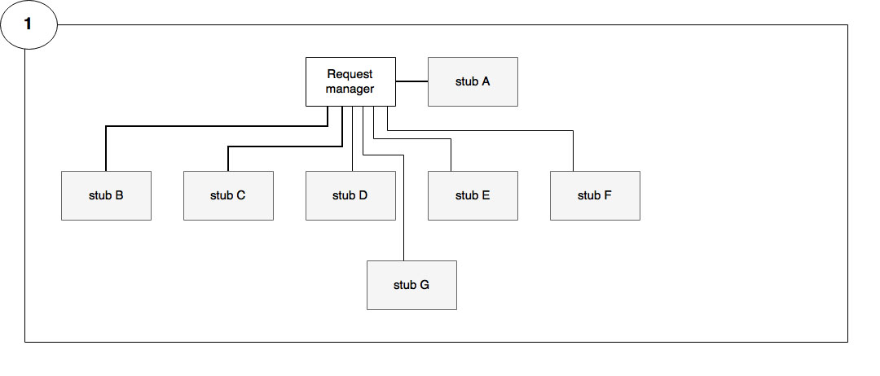
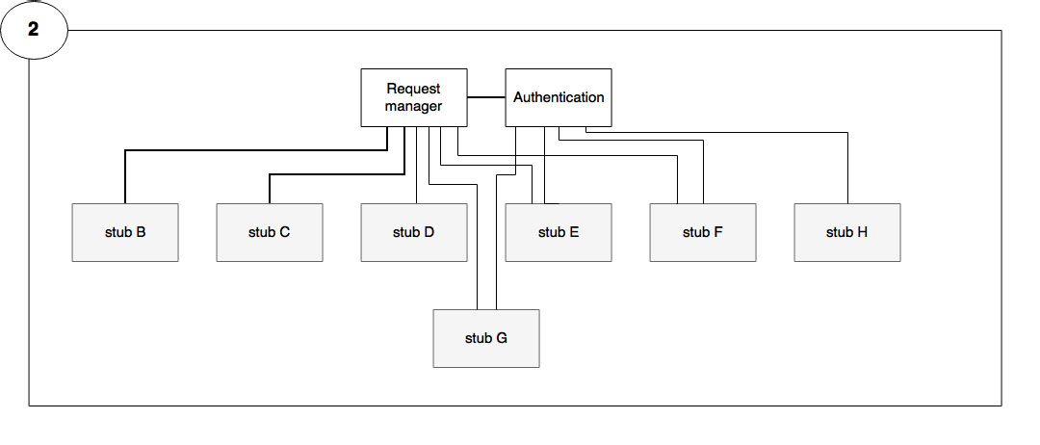
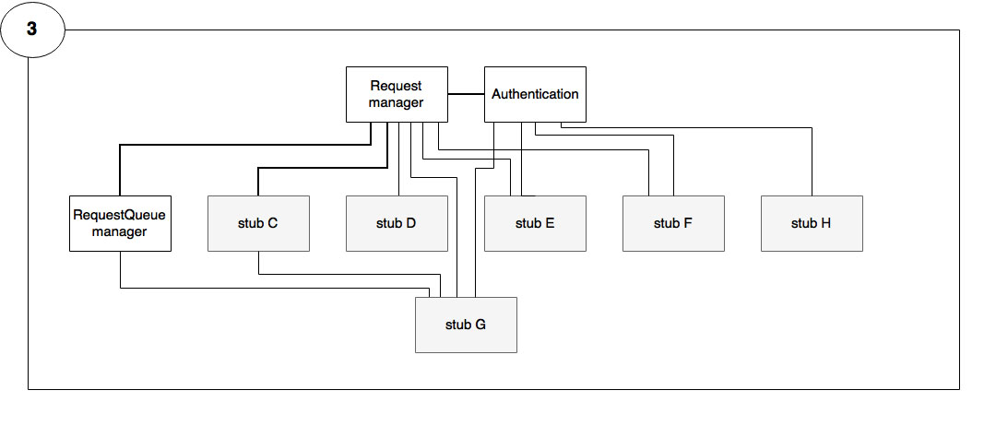
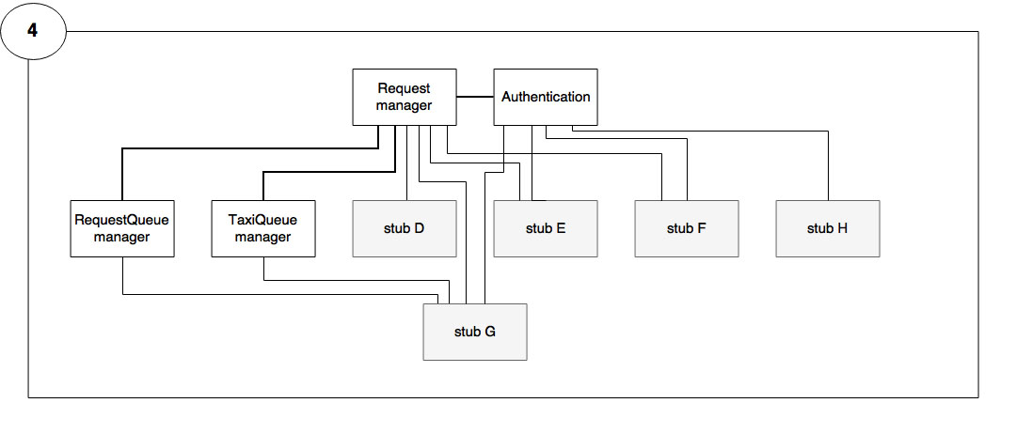
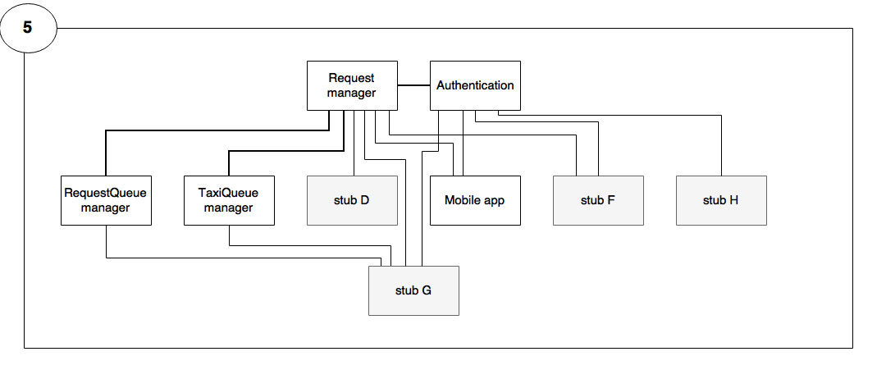
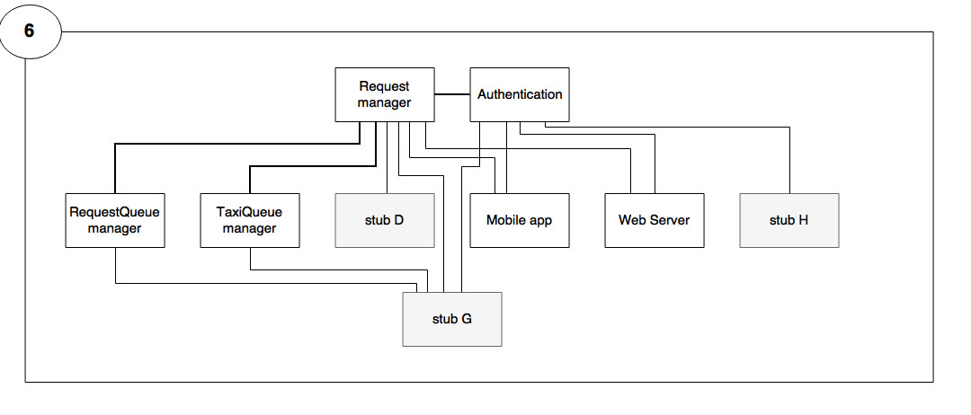
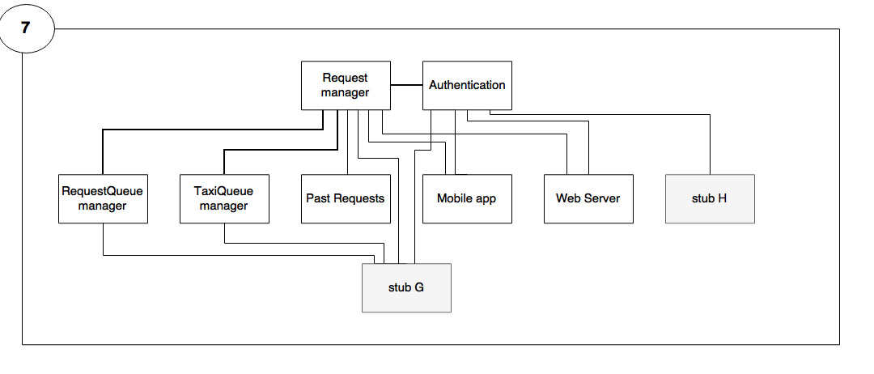
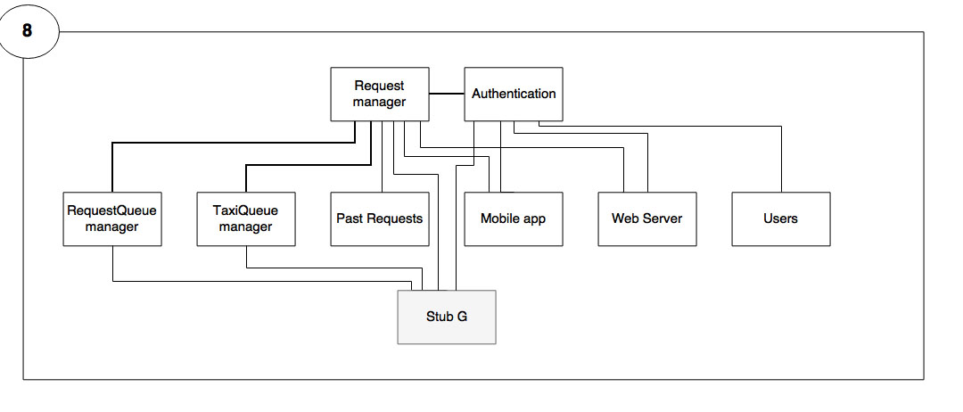
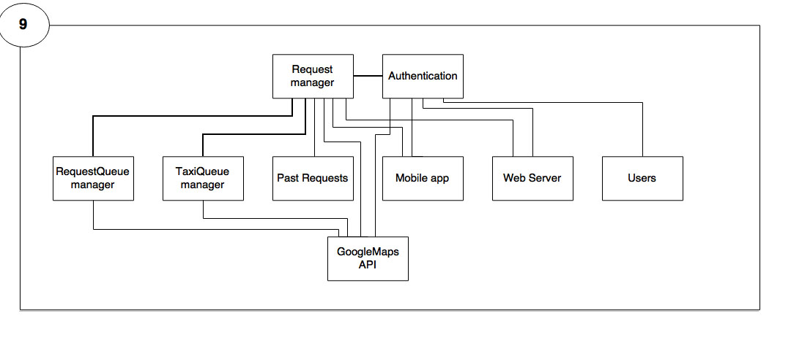
INTEGRATION ORDER

Slide 26
TABLE OF INTEGRATION
ID | Integration Test |  | Paragraphs
I1 | RequestManager → Authentication |  | 3.1
I2 | RequestManager → RequestQueueManager |  | 3.2
I3 | RequestManager → TaxiQueueManager |  | 3.3
I4 | RequestManager, Authentication → MobileApp |  | 3.4
I5 | RequestManager, Authentication → WebServer |  | 3.5
I6 | RequestManager → PastRequest |  | 3.6
I7 | Authentication → Users |  | 3.7
I8 | RequestManager, Authentication, RequestQueueManager, TaxiQueueManager | → GoogleMapsAPI | 3.8

Slide 27
Assignment 5: PROJECT REPORTING

Slide 28
FUNCTION
POINTS

Slide 29
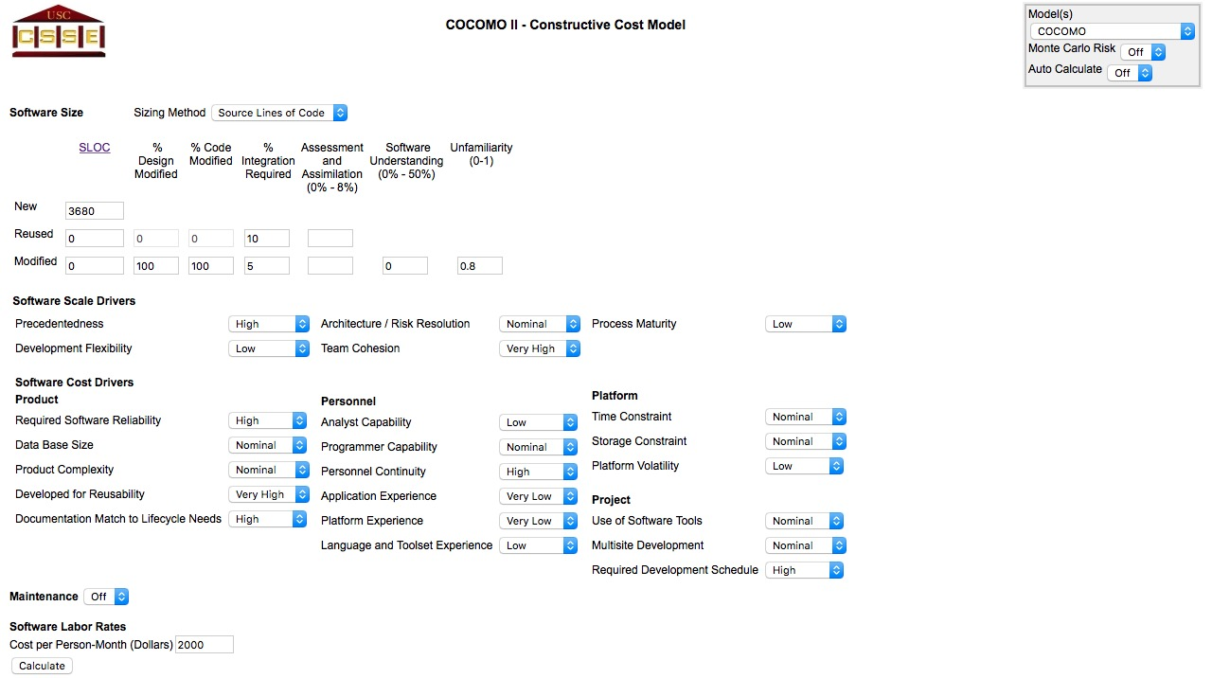
COCOMO APPROACH

Slide 30
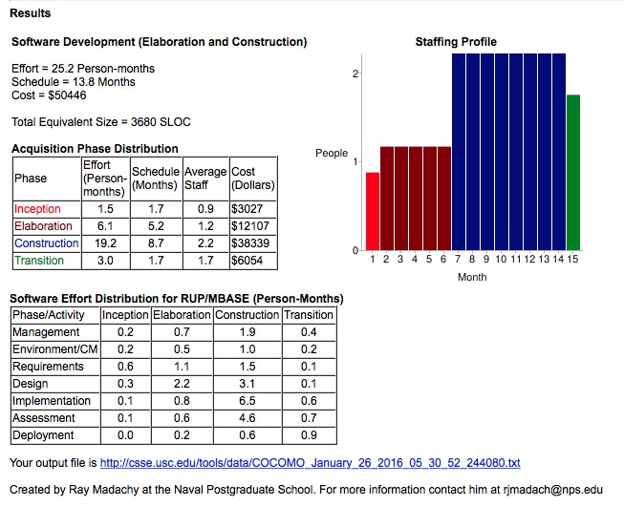
COCOMO APPROACH

